Slide 1

01/01/2017 24:59:59
Bypass
Analyze
Approval
Workflow
Group
Export
InControl
Username
Password
Login
Forget password?

Slide 2

Welcome, USERNAME (ROLE) 01/01/2017 24:59:59 Log out
Bypass
Analyze
Approval
Workflow
Group
Export
Start Workflow1 Bypass
Start WorkFlow2 Bypass
Request group
Declined Bypasses
List of approved or unrequested or active bypasses
scrollbar
Rechtermuisknop menu
Acknowledge (of vink aan of dubbelklik)
Open
Print
Edit request (when not bypassed)
Remove request (when not bypassed)

Slide 3
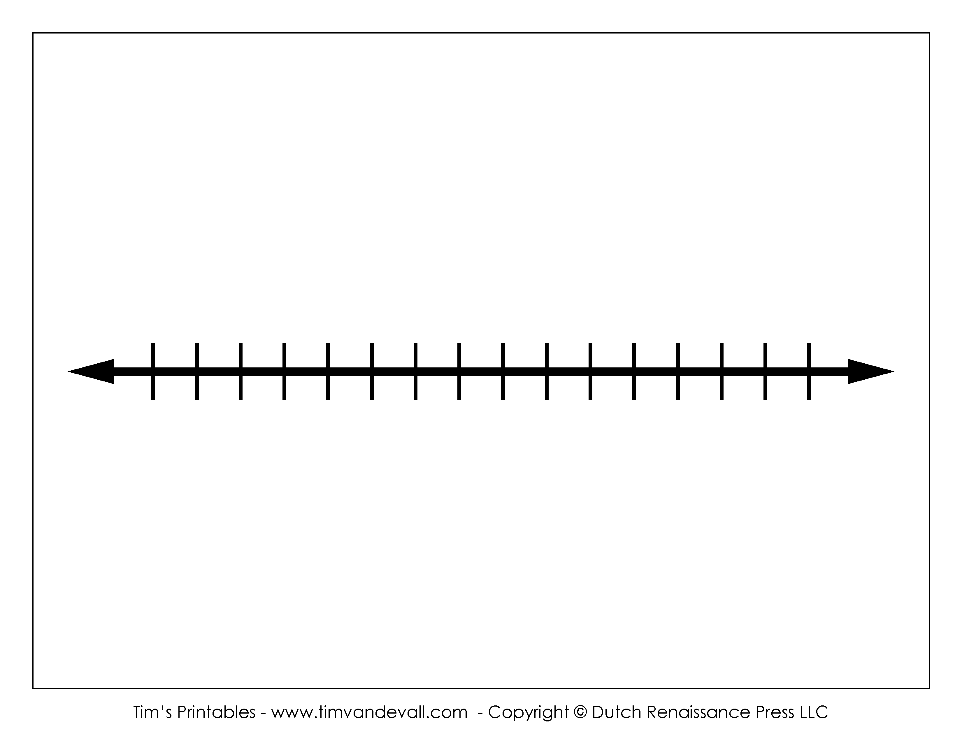
Welcome, USERNAME (ROLE) 01/01/2017 24:59:59 Log out
Bypass
Analyze
Approval
Workflow
Group
Export
Requested
Unrequested
Reasons
Acknowledge time
From
To

Slide 4
Welcome, USERNAME (ROLE) 01/01/2017 24:59:59 Log out
Bypass
Analyze
Approval
Workflow
Group
Export
Approval Workflow1
Approval WorkFlow2
Approval Group
List of requested bypasses
Approval form:
Bypass details:
…
…
…
scrollbar
Rechtermuisknop menu
Open (of vink aan of dubbelklik)
Motivation input (required for both)
Approve
Decline

Slide 5
Welcome, USERNAME (ROLE) 01/01/2017 24:59:59 Log out
OLD
Bypass
Analyze
Approval
Workflow
Group
Export
Workflow1
WorkFlow2
Event | Action | Setting
Start Workflow1 Bypass | Move to Approval list | Workflow1
Start Workflow2 Bypass | Move to Approval list | Workflow2
Start Workflow1 Bypass | Email | Manager
Approval Workflow1 Bypass | Move to Bypass
Decline Workflow1 Bypass | Move to Decline list
Decline Workflow1 Bypass | Email | Requested user
….
scrollbar

Slide 6
Welcome, USERNAME (ROLE) 01/01/2017 24:59:59 Log out
Bypass
Analyze
Approval
Workflow
Group
Export
Request “Label1”
Request “Label2”
Request group
Declined Bypasses
List of approved or unrequested or active bypasses
scrollbar
Rechtermuisknop menu
Acknowledge (of vink aan of dubbelklik)
Open
Print
Edit request (when not bypassed)
Remove request (when not bypassed)
Notes:
Zie settings page workflow

Slide 7
Welcome, USERNAME (ROLE) 01/01/2017 24:59:59 Log out
Bypass
Analyze
Approval
Workflow
Group
Export
Workflow1 Label: “No Approval” (Default)
Workflow2 Label: “Approval” (Default)
Request (from button)
Request (from button)
Approval
Approval
Views based
on selection
Not Required
Manager
Move to Bypass
Move to Approval
Notification
Wait for Approval
Reminder (Timeout)
Approved
No
Move to Declined
Selector
Not required
Chief
Manager
… (=list roles)
Yes
Selector
Move to Bypass
No
Email: Role
Notes:
Zie settings page workflow

Slide 8

Welcome, USERNAME (ROLE) 01/01/2017 24:59:59 Log out
Bypass
Analyze
Approval
Workflow
Group
Export
New
Edit
Remove
Group name*
Search
Module
scrollbar
Condition
Description
Results
Selected
Create

Slide 9
Welcome, USERNAME (ROLE) 01/01/2017 24:59:59 Log out
Bypass
Analyze
Approval
Workflow
Group
Export
CSV
Excel
XML
From
To
List of events and data
scrollbar

Slide 10

Welcome, USERNAME (ROLE) 01/01/2017 24:59:59 Log out
Bypass
Analyze
Approval
Workflow
Group
Export
General
Modules
Users
Roles
Email
Based on v1 settings and new available settings of v2

Slide 11
Role /Rights Matrix
 | Administrator | Configurator | Manager | Chief | Operator | Custom
Settings
User/role management | x | x
Password expires | x
General Configuration | x | x
Module Configuration | x | x
Email settings | x | x
Bypasses
View Bypasses | x | x | x | x | x
Request Workflow1 | x | x |  | x | x
Request Workflow2 | x | x |  | x
Acknowledge unrequested |  |  |  | x | x
View declined list | x | x | x | x | x
Analyze
View analyze | x | x | x | x
View historian | x | x | x | x | x
Use Export | x | x | x | x
Approval
View all requested |  |  |  |  | x
Approve requested approvals (role based) | x | x | x | x
Bypass group
Create | x | x |  | x
Approve |  |  | x
Use |  |  |  | x | x
Workflow
View | x | x | x | x | X
Configure | x | x

